Slide 1
Data story Telling
Prince Zogli, Springboard
Data Science

Slide 2
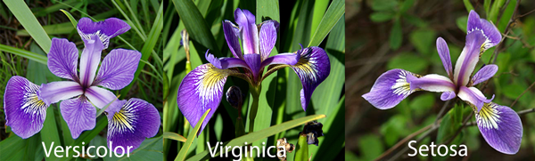
SVM Classification of Iris flower
How does length measurements compliment obvious differences observed in Iris flower species ?
SVM will be used due to multi-classification challenge associated with Iris data.

Slide 3
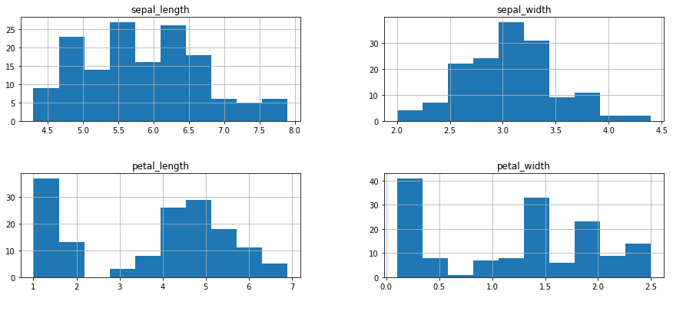
What is the distribution of the data?
Mean length of sepal: 6 , sepal width:~3, Petal length: ~4, petal width: ~1.5 , See Next slide

Slide 4
What is the distribution of the data?
 | sepal_length | sepal_width | petal_length | petal_width
count | 150.000000 | 150.000000 | 150.000000 | 150.000000
mean | 5.843333 | 3.054000 | 3.758667 | 1.198667
std | 0.828066 | 0.433594 | 1.764420 | 0.763161
Min | 4.300000 | 2.000000 | 1.000000 | 0.100000
25% | 5.100000 | 2.800000 | 1.600000 | 0.300000
50% | 5.800000 | 3.000000 | 4.350000 | 1.300000
75% | 6.400000 | 3.300000 | 5.100000 | 1.800000
Max | 7.900000 | 4.400000 | 6.900000 | 2.500000

Slide 5
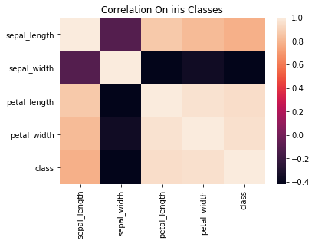
What is the correlation among length features?
Sepal and petal length shows negative correction with width

Slide 6
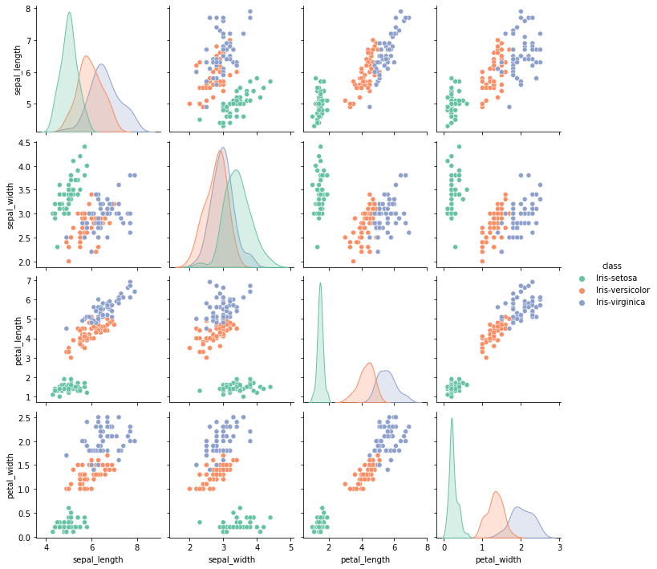
How do the three species cluster
Though, Setosa has the smallest Petal length, it has the wider sepal relative to virginica and versicolor

Slide 7
How accurate is an SVM model prediction
precision recall f1-score support
1 1.00 1.00 1.00 13
2 1.00 0.94 0.97 16
3 0.90 1.00 0.95 9
accuracy 0.97 38
macro avg 0.97 0.98 0.97 38
weighted avg 0.98 0.97 0.97 38
The model has a 97.2% prediction accuracy, will be a good model to predict Iris flower type

Slide 8
Thank you

